Slide 1
Please delete before presenting
These slides and their contents are free to reuse through Creative Commons: CC BY-SA 3.0
There are two slides in this deck for you to choose from.
Background information about the Portal is included in the notes section of the slides. If you need any more information, please get in touch: Contact@chemprobes.org
Please help us spread the word about chemical probes and the Chemical Probes Portal and improve the use of chemical probes in biomedical research.
Thank you for supporting the Portal!

Slide 2
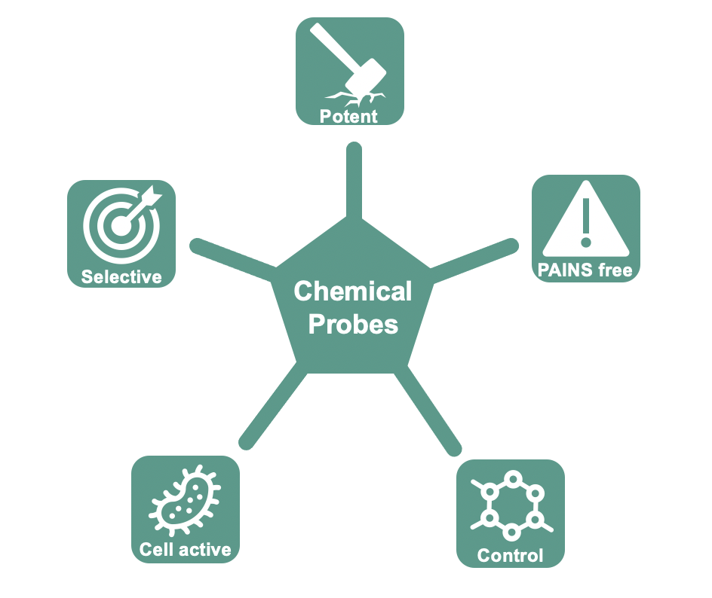
The Chemical Probes Portal
A free, public resource to select the best chemical tools for a protein target
Find expert recommendations and guidance on the right inhibitor for your experiment
Hundreds of small-molecule inhibitors, PROTACs, molecular glues and agonists
Search by compound name or protein target
Expert ratings for chemical tools
Arrowsmith et al. Nat Chem Biol (2015), Antolin et al. Future Med Chem (2019)
www.chemicalprobes.org
@Chemical_Probes
Chemical Probes Portal
Notes:
The Chemical Probes Portal has recently released a new website, including an improved search function, and featuring criteria to evaluate new types of compounds like PROTACs and molecular glues. New probes are reviews are continually added, with over 750 compounds and 350 targets at the beginning of 2022.
The Portal is looking for recommendations for new probes or targets to include and new members to add to our Scientific Expert Review Panel (SERP).
Please spread the word and help improve the use of chemical probes in biomedical research.
Background:
The Chemical Probes Portal is a free, open science resource to provide researchers with information and expert guidance to choose the best chemical probes for their research. The website has recently been rebuilt, including an easier search function and improved user experience. New probes and reviews are continually added, including more than 750 compounds and 350 targets at the beginning of 2022.
Using chemical probes appropriately is one of the biggest issues in biomedical research – ensuring that data gathered from experiments with inhibitors is robust and of high quality. Chemical probes should be potent, selective within and outside the protein family, have demonstrable activity in cells (or on target for extracellular targets), and be used with appropriate controls, and good probes are not widely toxic to cells or reactive with assay components.
The Portal features hundreds of protein targets and different chemical tools that target them, including inhibitors, PROTACs, molecular glues, agonists and antagonists. For each compound, three experts review and rate the probe, providing advice and recommendations on their use as well as confirming the recommended concentration for cellular and in vivo experiments.
Researchers can look for data and expert recommendations on their favourite chemical tool, or help answer: Which is the best probe to target this protein? Which alternative probes and controls can I use?
The Portal is continually growing, and always open to recommendations for probes, targets or expert reviewers. Please spread the word and help improve the use of chemical probes in biomedical research.
For more information, please contact us on social media or at contact@chemprobes.org.
CC BY-SA 3.0 This slide and the Chemical Probes Portal are open access and free to reuse with recognition.

Slide 3
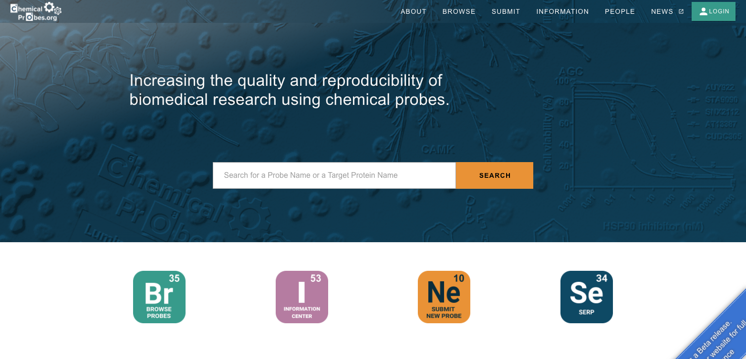
The Chemical Probes Portal
A free, public resource to select the best chemical tools for a protein target
Find expert recommendations and guidance on the right inhibitor for your experiment
Hundreds of small-molecule inhibitors, PROTACs, molecular glues and agonists
Search by compound name or protein target
Expert ratings for chemical tools
Arrowsmith et al. Nat Chem Biol (2015), Antolin et al. Future Med Chem (2019)
www.chemicalprobes.org
@Chemical_Probes
Chemical Probes Portal
Notes:
The Chemical Probes Portal has recently released a new website, including an improved search function, and featuring criteria to evaluate new types of compounds like PROTACs and molecular glues. New probes are reviews are continually added, with over 750 compounds and 350 targets at the beginning of 2022.
The Portal is looking for recommendations for new probes or targets to include and new members to add to our Scientific Expert Review Panel (SERP).
Please spread the word and help improve the use of chemical probes in biomedical research.
Background:
The Chemical Probes Portal is a free, open science resource to provide researchers with information and expert guidance to choose the best chemical probes for their research. The website has recently been rebuilt, including an easier search function and improved user experience. New probes and reviews are continually added, including more than 750 compounds and 350 targets at the beginning of 2022.
Using chemical probes appropriately is one of the biggest issues in biomedical research – ensuring that data gathered from experiments with inhibitors is robust and of high quality. Chemical probes should be potent, selective within and outside the protein family, have demonstrable activity in cells (or on target for extracellular targets), and be used with appropriate controls, and good probes are not widely toxic to cells or reactive with assay components.
The Portal features hundreds of protein targets and different chemical tools that target them, including inhibitors, PROTACs, molecular glues, agonists and antagonists. For each compound, three experts review and rate the probe, providing advice and recommendations on their use as well as confirming the recommended concentration for cellular and in vivo experiments.
Researchers can look for data and expert recommendations on their favourite chemical tool, or help answer: Which is the best probe to target this protein? Which alternative probes and controls can I use?
The Portal is continually growing, and always open to recommendations for probes, targets or expert reviewers. Please spread the word and help improve the use of chemical probes in biomedical research.
For more information, please contact us on social media or at contact@chemprobes.org.
CC BY-SA 3.0 This slide and the Chemical Probes Portal are open access and free to reuse with recognition.

